Slide 1
Computer Graphics
Viewing & Clipping
By Jignesh Patel

Slide 2
Windowing I
A scene is made up of a collection of objects specified in world coordinates
World Coordinates

Slide 3
Windowing II
When we display a scene only those objects within a particular window are displayed
Window
wy_{max}
wy_{min}
wx_{min}
wx_{max}
World Coordinates

Slide 4
Windowing III
Because drawing things to a display takes time, we clip everything outside the window
Window
wy_{max}
wy_{min}
wx_{min}
wx_{max}
World Coordinates

Slide 5
Window & Viewport
Window/clipping window
  a world-coordinate area selected for display
  define what is to be viewed
  (e.g. House in world coordinate can be in Feet)
view port
  an area on a display device to which a window is mapped
  define where it is to be displayed
  (e.g. House can be in centimeter)

Slide 6
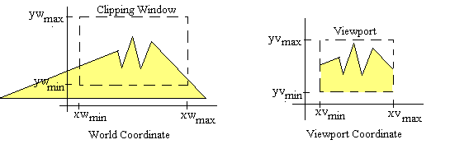
Clipping Window
The clipping window selects what we want to see; the viewport indicates where it is to be viewed on the output device.

Slide 7
Clipping Window
We could design our own clipping window with any shape, size and orientation.
But clipping a scene using nonlinear boundaries requires more processing than clipping against a rectangle.
Therefore, graphics packages commonly allow only rectangular clipping windows aligned with the x and y axes.

Slide 8
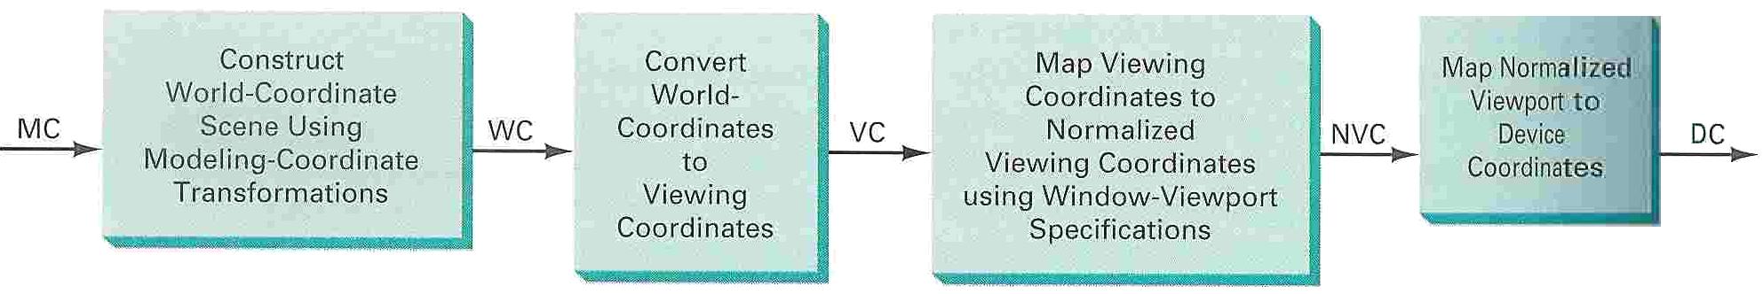
2D Viewing Pipeline
The mapping of a 2D world-coordinate scene description to device coordinates is called a 2D viewing transformation or window-to-viewport transformation.

Slide 9
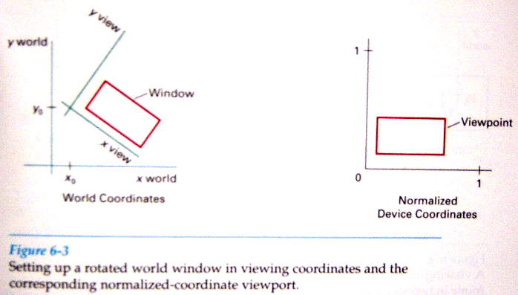
2D Viewing Transformation
2D viewing transformation is to set up a viewing coordinate system within the world coordinate frame.

Slide 10
2D Viewing Pipeline
To make the viewing process independent of the requirements of any output device, graphics systems convert object descriptions to normalized coordinates range from 0 to 1
Called clipping window -> normalized viewport mapping
Construct World coordinate scene using Modeling transformation
Viewport
Coordinates
Normalized
Coordinates
Device
Coordinates

Slide 11
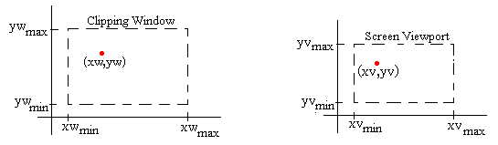
Clipping Window -> Normalized Viewport
Object descriptions are transferred to this normalized space using a transformation that maintains the same relative placement of a point in the viewport as it had in the clipping window.

Slide 12
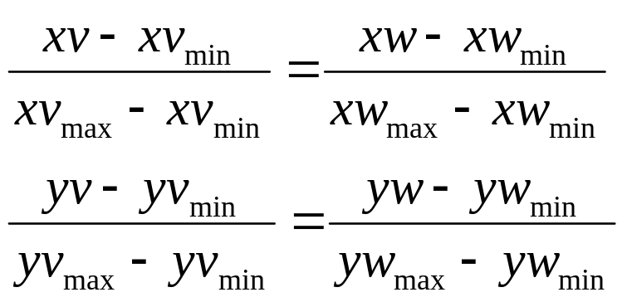
Clipping Window -> Normalized Viewport
To transform the world-coordinate point into the same relative position within the viewport, we require that

Slide 13
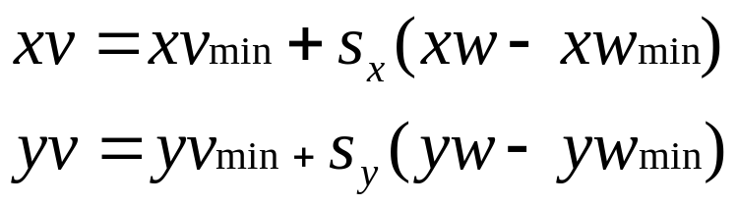
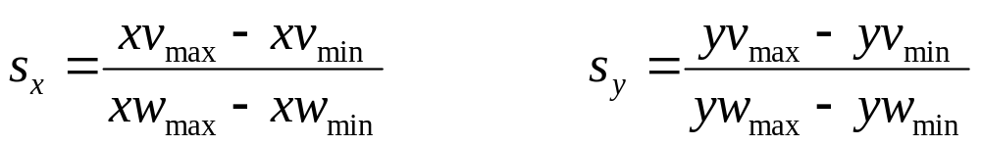
Clipping Window -> Normalized Viewport
Solving these expressions for the viewport position (xv,yv) we have:
where

Slide 14
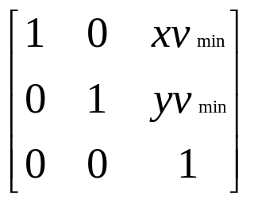
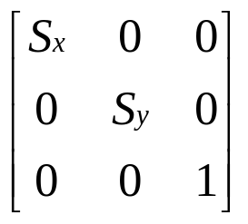
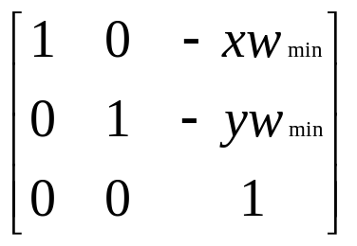
Clipping Window -> Normalized Viewport
We could obtain the transformation from world coordinates to viewport coordinates with the sequence (in reverse order):
  Translate
  Scale
  translate

Slide 15
Clipping Window -> Normalized Viewport
The window-to-viewport transformation maintains the relative placement of object descriptions.
Relative proportions of objects are maintained only if the aspect ratio of the viewport is the same as the aspect ratio of the clipping window.

Slide 16
Clipping Algorithms

Slide 17
Clipping Algorithm
Clipping algorithm is a procedure that eliminates those portions of a picture that are either inside or outside of a specified region (clipping window).
2D algorithms are:
  Point Clipping
  Line Clipping (straight-line)
  Fill-Area Clipping (polygon)
  Text Clipping

Slide 18
Clipping
For the image below consider which lines and points should be kept and which ones should be clipped
P₄
Window
P₂
wy_{max}
P₃
P₆
P₁
P₇
P₅
P₉
P₈
wy_{min}
P₁₀
wx_{min}
wx_{max}

Slide 19
Point Clipping
Easy - a point (x,y) is not clipped if:
wx_{min} ≤ x ≤ wx_{max} AND wy_{min} ≤ y ≤ wy_{max}
otherwise it is clipped
P₄
Clipped
Clipped
Window
P₂
wy_{max}
Clipped
P₅
P₇
P₁
Points Within the Window are Not Clipped
P₉
P₈
wy_{min}
Clipped
P₁₀
wx_{min}
wx_{max}

Slide 20
Line Clipping
Harder - examine the end-points of each line to see if they are in the window or not
Situation | Solution | Example
Both end-points inside the window | Don’t clip
One end-point inside the window, one outside | Must clip
Both end-points outside the window | Don’t know!

Slide 21
Brute Force Line Clipping
Brute force line clipping can be performed as follows:
  Don’t clip lines with both
  end-points within the
  window
  For lines with one end-
  point inside the window
  and one end-point
  outside, calculate the
  intersection point (using the equation of the line) and clip from this point out

Slide 22
Brute Force Line Clipping (cont…)
  For lines with both end-points outside the window test the line for intersection with all of the window boundaries, and clip appropriately
However, calculating line intersections is computationally expensive
Because a scene can contain so many lines, the brute force approach to clipping is much too slow

Slide 23
2D Line Clipping
Clipping approach is straightforward, but not efficient.
To reduce processing time, a number of faster line clippers have been developed:
  Cohen-Sutherland Line Clipping
  Liang-Barsky Line Clipping
  Nicholl-Lee-Nicholl Line Clipping

Slide 24
Cohen-Sutherland Clipping Algorithm
An efficient line clipping algorithm
The key advantage of the algorithm is that it vastly reduces the number of line intersections that must be calculated

Slide 25
Cohen-Sutherland: World Division
World space is divided into regions based on the window boundaries
  Each region has a unique four bit region code
  Region codes indicate the position of the regions with respect to the window
1001 | 1000 | 1010
0001 | 0000 Window | 0010
0101 | 0100 | 0110
3
2
1
0
above
below
right
left
Region Code Legend

Slide 26
Cohen-Sutherland: Labelling
Every end-point is labelled with the appropriate region code
P₁₁ [1010]
P₄ [1000]
Window
wy_{max}
P₆ [0000]
P₃ [0001]
P₅ [0000]
P₁₂ [0010]
P₇ [0001]
P₉ [0000]
P₈ [0010]
wy_{min}
P₁₀ [0100]
P₁₃ [0101]
P₁₄ [0110]
wx_{min}
wx_{max}

Slide 27
Cohen-Sutherland: Lines In The Window
Lines completely contained within the window boundaries have region code [0000] for both end-points so are not clipped
P₁₁ [1010]
P₄ [1000]
Window
wy_{max}
P₆ [0000]
P₃ [0001]
P₅ [0000]
P₁₂ [0010]
P₇ [0001]
P₉ [0000]
P₈ [0010]
wy_{min}
P₁₀ [0100]
P₁₃ [0101]
P₁₄ [0110]
wx_{min}
wx_{max}

Slide 28
Cohen-Sutherland: Lines Outside The Window
Any lines with a common set bit in the region codes of both end-points can be clipped
  The AND operation can efficiently check this
P₁₁ [1010]
P₄ [1000]
Window
wy_{max}
P₆ [0000]
P₃ [0001]
P₅ [0000]
P₁₂ [0010]
P₇ [0001]
P₉ [0000]
P₈ [0010]
wy_{min}
P₁₀ [0100]
P₁₃ [0101]
P₁₄ [0110]
wx_{min}
wx_{max}

Slide 29
Cohen-Sutherland: Other Lines
Lines that cannot be identified as completely inside or outside the window may or may not cross the window interior
These lines are processed as follows:
  Compare an end-point outside the window to a boundary (choose any order in which to consider boundaries e.g. left, right, bottom, top) and determine how much can be discarded
  If the remainder of the line is entirely inside or outside the window, retain it or clip it respectively

Slide 30
Cohen-Sutherland: Other Lines (cont…)
  Otherwise, compare the remainder of the line against the other window boundaries
  Continue until the line is either discarded or a segment inside the window is found
We can use the region codes to determine which window boundaries should be considered for intersection
  To check if a line crosses a particular boundary we compare the appropriate bits in the region codes of its end-points
  If one of these is a 1 and the other is a 0 then the line crosses the boundary

Slide 31
Calculating Line Intersections
Intersection points with the window boundaries are calculated using the line-equation parameters
  Consider a line with the end-points (x₁, y₁) and (x₂, y₂)
  The y-coordinate of an intersection with a vertical window boundary can be calculated using:
  y = y₁ + m (x_{boundary} - x₁)
  where x_{boundary} can be set to either wx_{min} or wx_{max}

Slide 32
Calculating Line Intersections (cont…)
  The x-coordinate of an intersection with a horizontal window boundary can be calculated using:
  x = x₁ + (y_{boundary} - y₁) / m
  where y_{boundary} can be set to either wy_{min} or wy_{max}
  m is the slope of the line in question and can be calculated as m = (y₂ - y₁) / (x₂ - x₁)

Slide 33
Cohen-Sutherland Algorithm
Better than brute force, but not the best
Works well when number of lines, which can be clipped without further processing, is large compared to the size of the input set
Liang-Barsky algorithm
  Parametric line-clipping algorithm
  Significantly reduce intersection calculation than Cohen-Sutherland

Slide 34
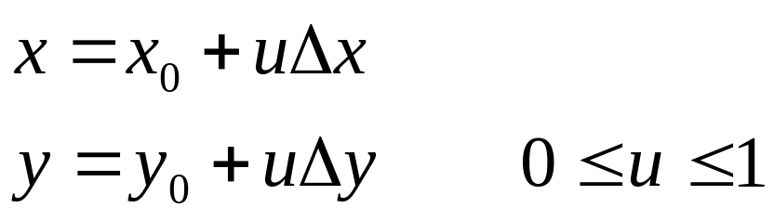
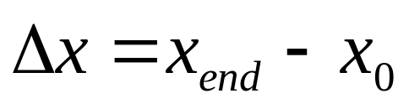
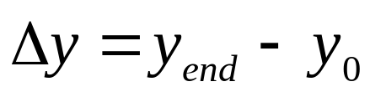
Liang-Barsky Line Clipping
For a line segment with endpoints (x₀, y₀) and (x_{end}, y_{end}), we can describe the line with parametric form:
where and

Slide 35
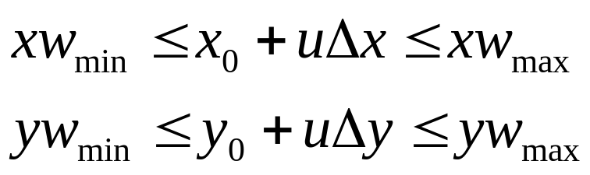
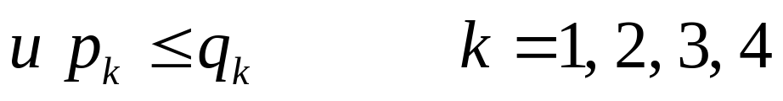
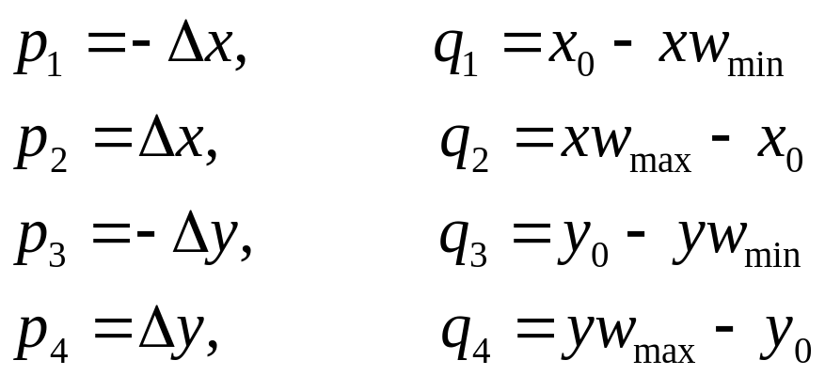
Liang-Barsky Line Clipping
With the point-clipping condition, we have:
which can be expressed as
where p and q are defined as

Slide 36
Liang-Barsky Line Clipping
Any line that is parallel to one of the clipping-window edges has p_{k}=0 for the value of k corresponding to that boundary where k = 1, 2, 3, 4 correspond to left, right, bottom and top.
  if q_{k}<0, then the line is completely outside the boundary.
  if q_{k}>=0, then the line is inside the parallel clipping border.

Slide 37
Liang-Barsky Line Clipping
When p_{k}<0, the line proceeds from the outside to the inside of this window edge.
If p_{k}>0, the line proceeds from the inside to the outside.

Slide 38
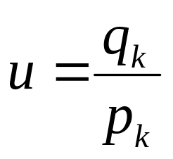
Liang-Barsky Line Clipping
For p_{k}≠0, we can calculate the value of u that is the intersection point of the line with the edge k where
For each line, calculate values for parameters u₁ and u₂, that defines the part of the line that lies within the clip window

Slide 39
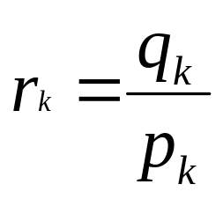
Liang-Barsky Line Clipping
u1 calculation:
  Determine the edges for which line proceeds from outside to inside (i.e. p_{k} < 0)
  For these edges, calculate
  The value of u1 is the largest 0 and various values of rk
u2 calculation
  Determine the edges for which line proceeds from inside to outside (i.e. p_{k} > 0)
  Calculate rk for these edges as before
  u2 is the least of the set containing 1 and the calculated rk values.

Slide 40
Liang-Barsky Line Clipping
If u1>u2, the line is completely outside.
If u1=0, u2=1, the line is completely inside
Otherwise, the endpoints of the clipped line are calculated from the two values of u
  u1=0, one intersection point - (x1,y1)
    x1=x0+u2.Δx, y1=yo+u2.Δy
  Otherwise two intersection points - (x1,y1), (x2,y2)
    x1=x0+u1.Δx, y1=yo+u1.Δy
    x2=x0+u2.Δx, y2=yo+u2.Δy

Slide 41
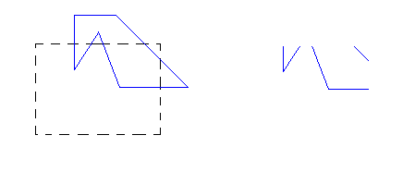
Fill-Area Clipping
To clip a polygon fill area, we cannot directly apply a line-clipping method to the individual polygon edges because this approach would not produce a closed polyline.

Slide 42
Sutherland-Hodgman Polygon Clipping
The output is generated according to the following tests:
For each boundary line, create vertex list as follows
    If the first input vertex is outside this border the second vertex is inside, both the intersection point and the second vertex are sent to the next clipper.
    If both input vertices are inside this border, only the second vertex are sent to the next clipper.
    If the first vertex is inside this border and the second vertex is outside, only the intersection position is sent to the next clipper.
    If both input vertices are outside this border, no vertices are sent to the next clipper.

Slide 43
Sutherland-Hodgman
Polygon Clipping
2
2’
Clipping
Window
3
2’’
1’
3’
1
Input
Edge
Left
Clipper
Right
Clipper
Bottom
Clipper
Top
Clipper
{1,2}: {2,3}: {3,1}: | (in-in)->{2} (in-out)->{2’} (out-in)->{3’,1} | {2,2’}:(in-in)->{2’} {2’,3’}:(in-in)->{3’} {3’,1}:(in-in)->{1} {1,2}:(in-in)->{2} | {2’,3’}:(in-out)->{2’’} {3’,1}:(out-out)->{} {1,2}:(out-in)->{1’,2} {2,2’}:(in-in)->{2’} | {2’’,1’}:(in-in)->{1’} {1’,2}:(in-in)->{2} {2,2’}:(in-in)->{2’} {2’,2’’}:(in-in)->{2’’}

Slide 44
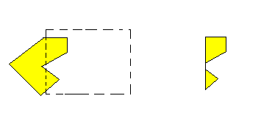
Sutherland-Hodgman Polygon Clipping
When a concave polygon is clipped with the Sutherland-Hodgman algorithm, extraneous lines may be displayed.
Since there is only one output vertex list, the last vertex in the list is always joined to the first vertex.

Slide 45
Weiler-Atherton Polygon Clipping
The algorithm can be used to clip a fill area that is either a convex polygon or a concave polygon.
Basic idea is that instead of always proceeding around polygon edges as vertices are processed, we sometimes want to follow window boundaries
A boundary is followed whenever a polygon edge crosses to the outside of that boundary.

Slide 46
Weiler-Atherton Polygon Clipping
Two rules
  For an outside-to-inside vertex pair, follow polygon boundary
  For an inside-to-outside vertex pair, follow window boundary
The direction of vertex traversal and window boundary traversal should be the same - clockwise

Slide 47
Weiler-Atherton Polygon Clipping
Steps:
  Process the edges of the fill area in a clockwise order until an inside-outside pair of vertices is encountered for one of the clipping boundaries.
  Follow the window boundaries in a clockwise direction from the exit-intersection point to another intersection point.
  Form the vertex list for this section of the clipped fill area.
  Return to the exit-intersection point and continue processing the polygon edges in a clockwise order.

Slide 48
Text Clipping
There are several techniques that can be used to provide text clipping.
The choice of clipping method depends on how characters are generated and what requirements we have for displaying character strings.

Slide 49
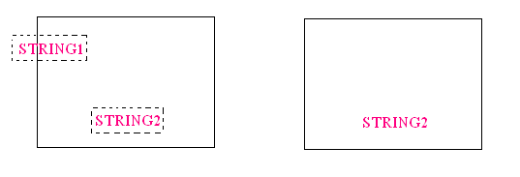
Text Clipping
The simplest method is to use the all-or-none string-clipping strategy.

Slide 50
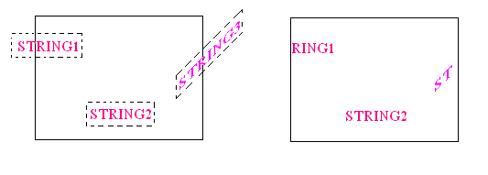
Text Clipping
An alternative is to use the all-or-none character-clipping strategy.

Slide 51
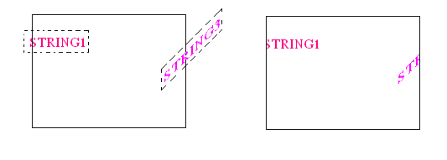
Text Clipping
A third approach is to clip the components of individual characters.
We treat characters in the same way that we treated lines or polygons.

